Slide 1
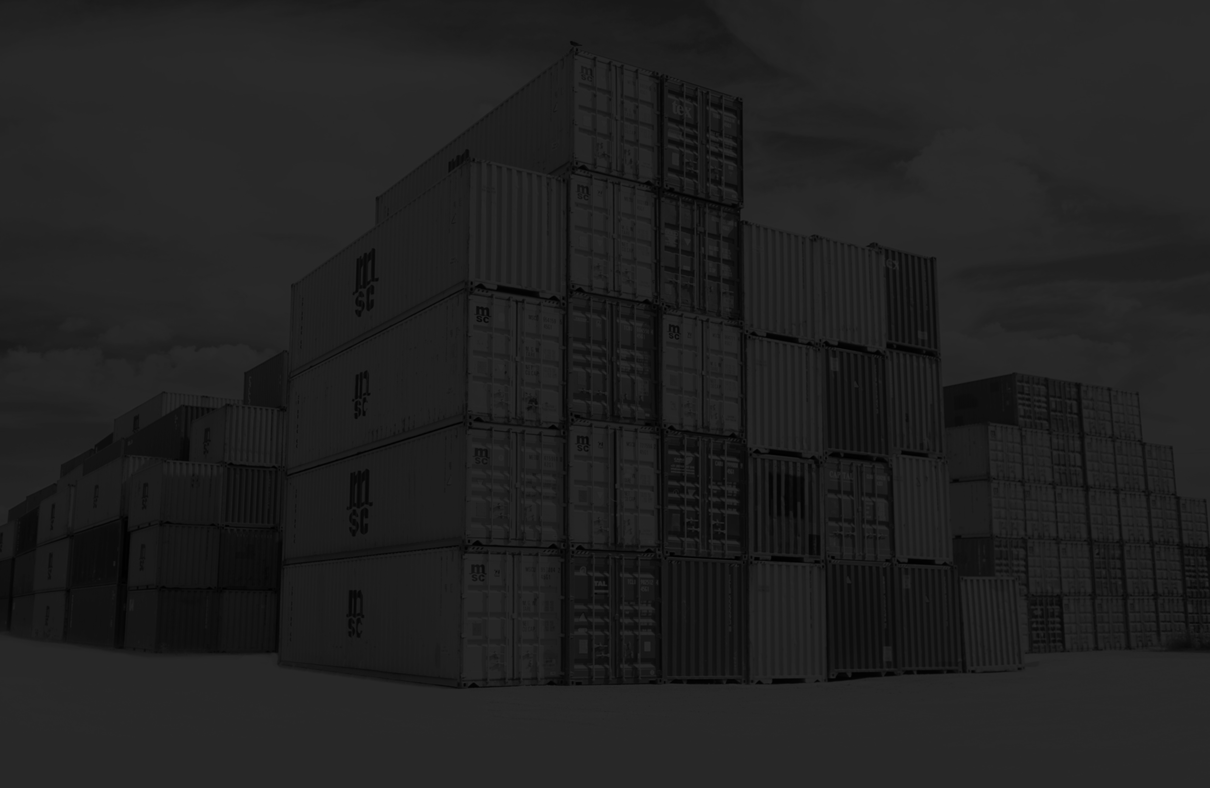
Containers
with Microsoft Azure
Notes:
Background thanks to: Photo by frank mckenna on Unsplash

Slide 2
What / Why / How

Slide 3
What / Why / How

Slide 4






COMPUTE EVOLUTION
Server
Datacentre
Virtual Machine
Container
Process
Function

Slide 5
CONTAINER
A container is a standard unit of software that packages up code and all its dependencies so the application runs quickly and reliably from one computing environment to another.

Slide 6
CONTENTS
CONTAINER
ENVIRONMENT
NETWORK
FILESYSTEM
CONFIGURATION
DEPENDENCIES
APPLICATION
ENTRY POINT

Slide 7
CONTAINER APPLICATION
CONTAINER INSTANCE
CONTAINER INSTANCE
CONTAINER INSTANCE
CONTAINER INSTANCE
CONTAINER INSTANCE
CONTAINER INSTANCE
CONTAINER RUNTIME
HOST OPERATING SYSTEM
INFRASTRUCTURE

Slide 8
What / Why / How

Slide 9
CLOUD REVENUE 2019
$3.76tn

Slide 10
$3,760,000,000,000
+3.2%

Slide 11


$3,760,000,000,000
1.88x

Slide 12
MULTI VENDOR CLOUD
Microsoft Azure: $36bn
Amazon Web Services: $29.72bn
Oracle: $26.4bn
IBM: $12.2bn
Google Cloud Platform: $4bn
Alibaba: $3.85bn

Slide 13
HYBRID CLOUD
Microsoft Azure Stack
ExpressRoute / VPN
Azure Active Directory
Azure Batch
Service Bus Relay
Azure Data Factory
SQL Server Stretch Database

Slide 14
VENDOR LOCK-IN
Services with single vendor provider
Improved speed to market
Careful application design
Switching costs
Specific features

Slide 15
CONTAINER BENEFITS
Reduced development cost
Application portability
Speed to deploy
Network isolation
Persistent storage
Standardised output

Slide 16
What / Why / How

Slide 17
DOCKER
A container implementation
Tools for image creation
Engine for hosting images
Networking capabilities
Docker Hub

Slide 18
DOCKERFILE
FROM mcr.microsoft.com/dotnet/core/aspnet:2.2 AS base
WORKDIR /app
EXPOSE 80
FROM mcr.microsoft.com/dotnet/core/sdk:2.2 AS build
WORKDIR /src
COPY HelloWorld.csproj HelloWorld.csproj
RUN dotnet restore HelloWorld.csproj
COPY . .
RUN dotnet build HelloWorld.csproj -c Release -o /app
FROM build AS publish
RUN dotnet publish HelloWorld.csproj -c Release -o /app
FROM base AS final
WORKDIR /app
COPY --from=publish /app .
ENTRYPOINT ["dotnet", "HelloWorld.dll"]

Slide 19
AZURE SERVICES
Virtual Machine
Azure Container Registry
Azure Container Instances
WebApp for Containers
Azure Container Services
Azure Kubernetes Service
Service Fabric
Service Fabric Mesh

Slide 20
AZURE CONTAINER REGISTRY
DEMO

Slide 21
AZURE CONTAINER REGISTRY
az group create --name <NAME> --location <LOCATION>
az acr create --name <NAME> \
--resource-group <GROUP> \
--sku basic \
--admin-enabled true
az acr task create --name <BUILD_TASK> \
--registry <NAME> \
--context <GIT_URL> \
--image <IMAGE>:{{.Run.ID}} \
--git-access-token <TOKEN> \
--os <OS> \
--commit-trigger-enabled true \
--branch <BRANCH> \
--file <DOCKERFILE_PATH>

Slide 22
AZURE CONTAINER INSTANCES
DEMO

Slide 23
AZURE CONTAINER INSTANCES
az container create --name <NAME> \
--resource-group <GROUP> \
--image <IMAGE> \
--os-type Linux \
--ip-address Public \
--ports <PORTS> \
--registry-login-server <ACR> \
--registry-username <USER> \
--registry-password <PASSWORD>

Slide 24
SERVICE FABRIC MESH
DEMO

Slide 25
SERVICE FABRIC MESH
PUBILC IP ADDRESS
GATEWAY
NETWORK (192.168.1.0/24)
APPLICATION
SERVICE
SERVICE
SERVICE
SERVICE
SECRETS
PERSISTENT STORAGE

Slide 26
SERVICE FABRIC MESH
az mesh deployment create
--resource-group <GROUP> \
--template-file <FILENAME> \
--parameters “{…}”

Slide 27
AZURE DEVOPS
ACR build tasks
GitHub repos
AppService
AKS, Draft and Helm
Service Fabric Deployment
Virtual machine DSC

Slide 28
SCALABLE / PORTABLE / ENCAPSULATED
DEVOPS / ORCHESTRATION / VALUE

Slide 29
End.
Background photo by frank mckenna on Unsplash

